Slide 1
Digital Portfolio
STUDENT NAME: M.NOORUL AAFRIN
REGISTER NO AND NMID: 24134130500122012 and asanm41341324213012
DEPARTMENT: II-BCA
COLLEGE: DEEN COLLEGE OF ARTS AND SCIENCE

Slide 2
PROJECT TITLE
STUDENT DIGITAL PORTFOLIO

Slide 3


AGENDA
Problem Statement
Project Overview
End Users
Tools and Technologies
Portfolio design and Layout
Features and Functionality
Results and Screenshots
Conclusion
Github Link
3/21/2024 Annual Review

Slide 4

PROBLEM STATEMENT
There is a growing need for a simple, responsive, and user-friendly Student Digital Portfolio system that allows students to create and manage a personalized online portfolio without the need for complex backend systems or databases. By leveraging front-end web technologies like HTML, CSS, and JavaScript

Slide 5

PROJECT OVERVIEW
A Student Digital Portfolio is an online platform that allows students to present their academic achievements, skills, personal projects, certifications, and extracurricular activities in a visually organized and professional manner. This project focuses on building a fully front-end web application using HTML, CSS, and JavaScript, without requiring any backend or database.

Slide 6

WHO ARE THE END USERS?
Students
The main users who create and manage their own digital portfolio to showcase their skills, projects, and achievements.
Teachers / Mentors
Review student portfolios for academic evaluation and give feedback.
Recruiters / Employers
View portfolios to assess a student's qualifications for internships or jobs.
Peers / Classmates
View and learn from each other's portfolios for inspiration or collaboration.

Slide 7

TOOLS AND TECHNIQUES
Code Editor
Example: Visual Studio Code, Sublime Text, Atom Used to write and manage HTML, CSS, and JavaScript code.
Web Browser
Example: Google Chrome, Firefox, Edge For testing and previewing the portfolio.
Techniques:
HTML (HyperText Markup Language) – To structure the content (e.g., headings, sections, forms, links).
CSS (Cascading Style Sheets) – To style the portfolio with colors, fonts, layouts, and responsive design.

Slide 8
POTFOLIO DESIGN AND LAYOUT
Logo or Name
Navigation links (Home, About, Projects, Skills, Contact)
Optional: Dark/Light mode toggle (JavaScript)
Home Section
Welcome message or tagline
Profile picture
Short introduction or role (e.g., “Computer Science Student”)
Call-to-action button (e.g., “VieHeader / Navigation Bar
w My Work” or “Download Resume”)
About Section
Brief bio
Educational background
Personal interests or career goals
8

Slide 9
FEATURES AND FUNCTIONALITY
Responsive Design
Works smoothly on all devices (desktop, tablet, mobile).
Implemented using CSS media queries and flexible layouts.
Navigation Bar
Fixed or scrollable navbar with links to different sections (Home, About, Projects, etc.).
Smooth scrolling using JavaScript or HTML anchor links.
Home/Landing Section
Welcome message or brief introduction.
Profile picture and background image.
Call-to-action button (e.g., “Download Resume”).

Slide 10
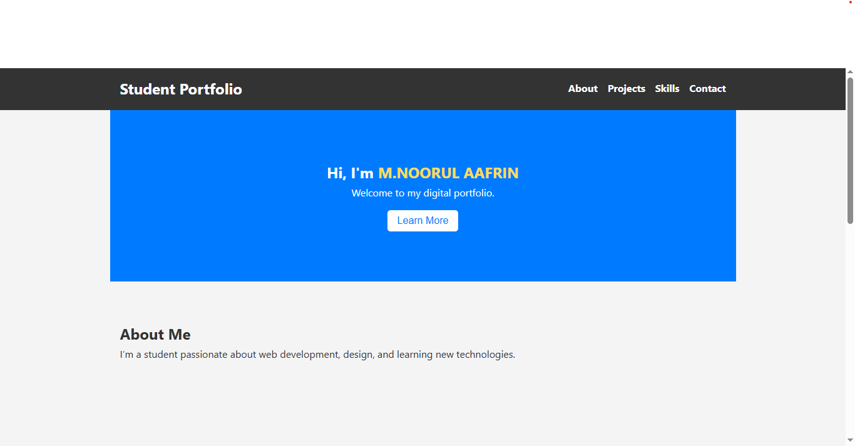

RESULTS AND SCREENSHOTS
3/21/2024 Annual Review
10

Slide 11
CONCLUSION
The Student Digital Portfolio developed using HTML, CSS, and JavaScript serves as a powerful and interactive platform for students to showcase their academic achievements, technical skills, personal projects, and professional aspirations. By using front-end web technologies, the portfolio is lightweight, fully responsive, and visually appealing, making it accessible across different devices and browsers without requiring backend support.
11

Slide 12
GITHUB LINK
https://github.com/dcca24aafrin-tech/M.NOORUL-AAFRIN-TNSDC-FWD-DP.git

